Slide 1
Data Structure and Algorithms
(CS212)
Instructor : Syed Musharaf Ali
ROOM G-104-DSE IIUI
Ph# 051-9019724 Ext-2724
Email: musharaf.ali@iiu.edu.pk

Slide 2
Tree
Tree is a non-linear data structure which organizes data in hierarchical structure
In tree data structure, every individual element is called as Node.
Node in a tree data structure stores the actual data of that particular element and link to next element in hierarchical structure.

Slide 3
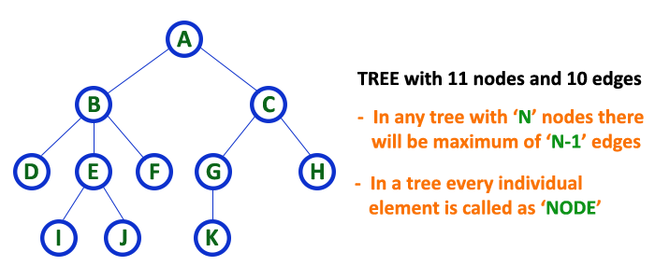
Tree

Slide 4
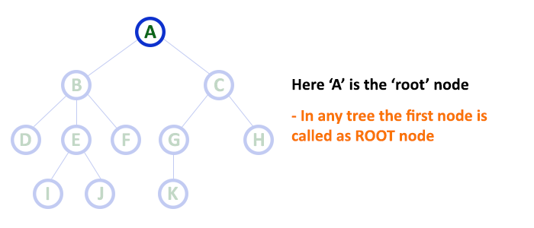
Root
In a tree data structure, the first node is called as Root Node. Every tree must have root node. We can say that root node is the origin of tree data structure. In any tree, there must be only one root node. We never have multiple root nodes in a tree.

Slide 5
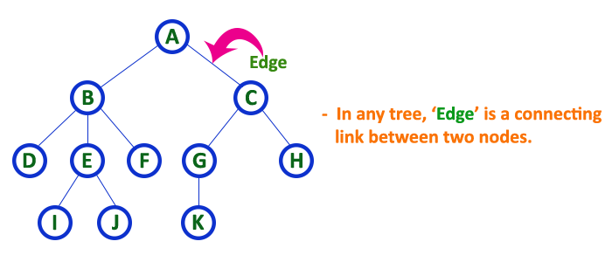
Edge
In a tree data structure, the connecting link between any two nodes is called as EDGE. In a tree with 'N' number of nodes there will be a maximum of 'N-1' number of edges.

Slide 6
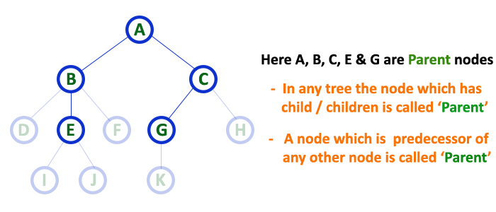
Parent/Internal Node
In a tree data structure, the node which is predecessor of any node is called as PARENT NODE. In simple words, the node which has branch from it to any other node is called as parent node. Parent node can also be defined as "The node which has child / children".

Slide 7
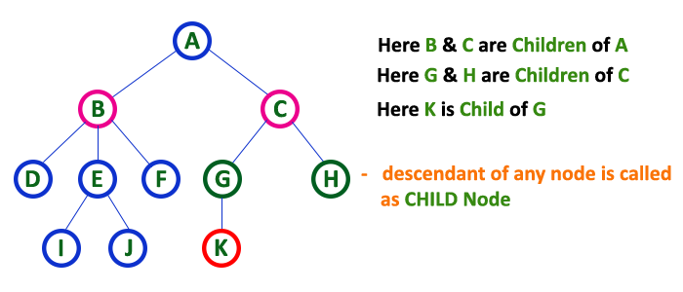
Child
In a tree data structure, the node which is descendant of any node is called as CHILD Node. In simple words, the node which has a link from its parent node is called as child node. In a tree, any parent node can have any number of child nodes. In a tree, all the nodes except root are child nodes.

Slide 8
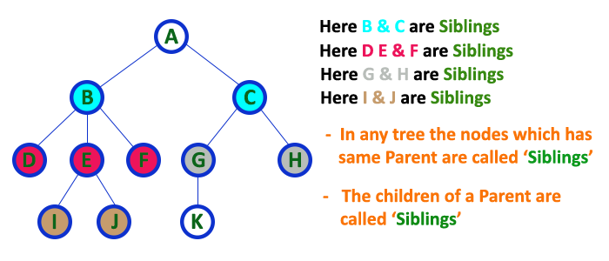
Siblings
In a tree data structure, nodes which belong to same Parent are called as SIBLINGS. In simple words, the nodes with same parent are called as Sibling nodes.

Slide 9
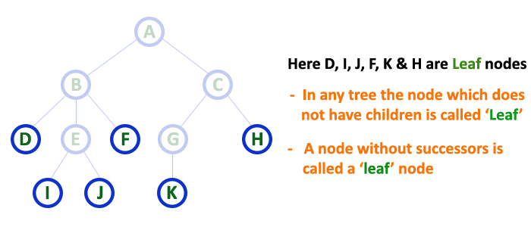
Leaf Node /External Node /Terminal Node
In a tree data structure, the node which does not have a child is called as LEAF Node. In simple words, a leaf is a node with no child.

Slide 10
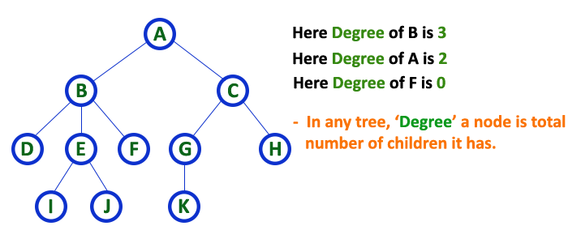
Degree
In a tree data structure, the total number of children of a node is called as DEGREE of that Node.
The highest degree of a node among all the nodes in a tree is called as 'Degree of Tree'

Slide 11
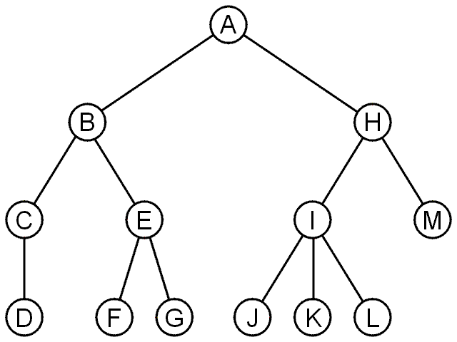
Tree
Degree | Nodes
0 | D, F, G, J, K, L, M
1 | C
2 | B, E, H
3 | I

Slide 12
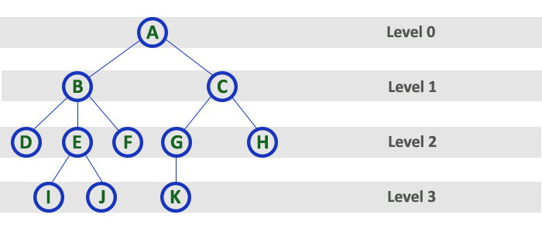
Level
The root node is said to be at Level 0 and the children of root node are at Level 1 and the children of the nodes which are at Level 1 will be at Level 2 and so on...

Slide 13
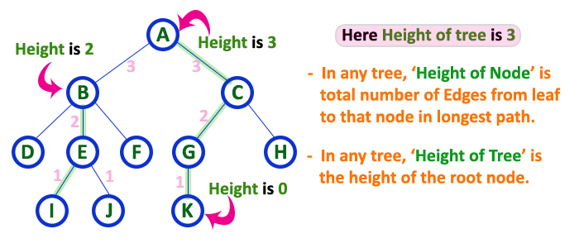
Height
In a tree data structure, the total number of edges from leaf node to a particular node in the longest path is called as HEIGHT of that Node. In a tree, height of the root node is said to be height of the tree. In a tree, height of all leaf nodes is '0'.

Slide 14
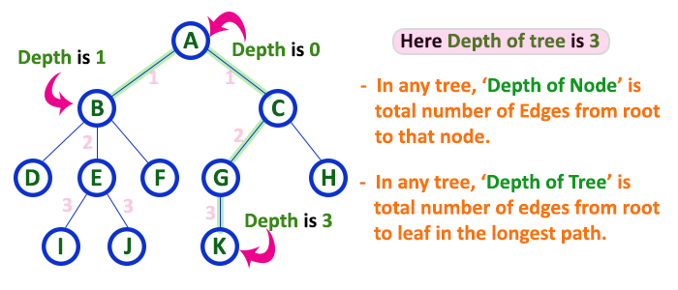
Depth
In a tree data structure, the total number of edges from root node to a particular node is called as DEPTH of that Node.
In a tree, the total number of edges from root node to a leaf node in the longest path is said to be Depth of the tree. In simple words, the highest depth of any leaf node in a tree is said to be depth of that tree. In a tree, depth of the root node is '0'.

Slide 15
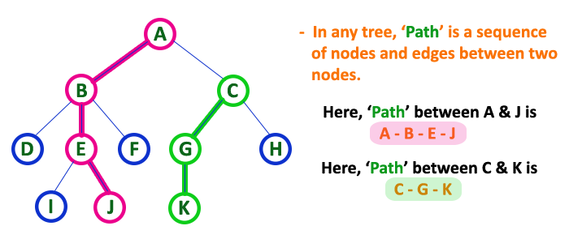
Path
The sequence of Nodes and Edges from one node to another node is called as PATH between that two Nodes.
Length of a Path is total number of nodes in that path. In below example the path A - B - E - J has length 4.

Slide 16
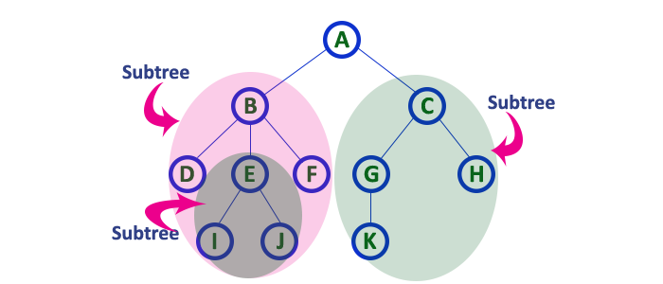
Sub Tree
In a tree data structure, each child from a node forms a subtree recursively.
Every child node will form a subtree on its parent node.

Slide 17
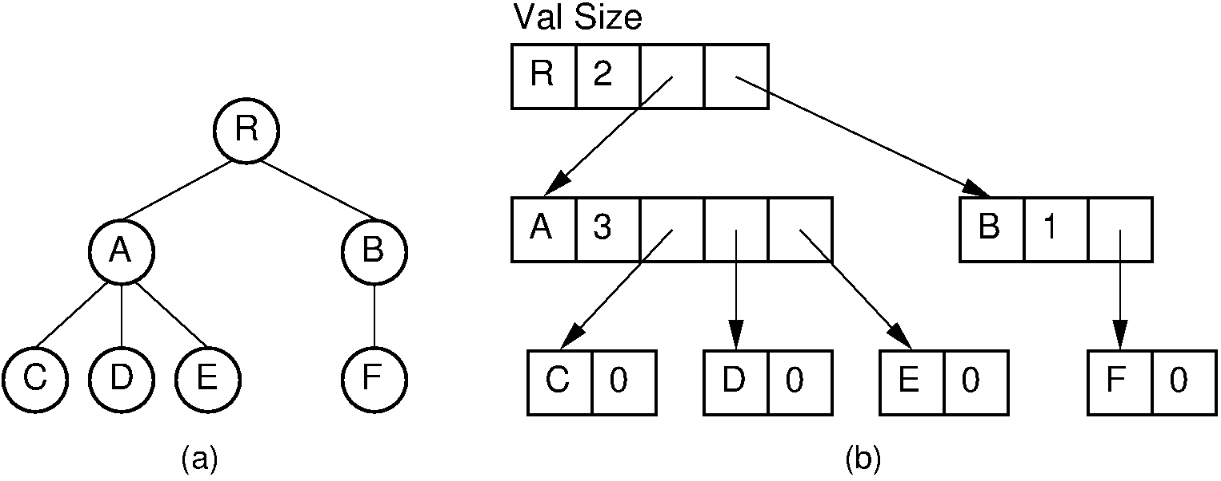
Tree Representation as List
The current number of children for each node is stored explicitly in a size field. The child pointers are stored in an array with size elements.

Slide 18
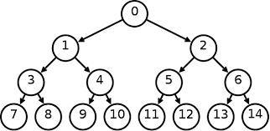
Binary Tree
A tree in which every node can have a maximum of two children is called as Binary Tree.
In a binary tree, every node can have either 0 children or 1 child or 2 children but not more than 2 children.

Slide 19
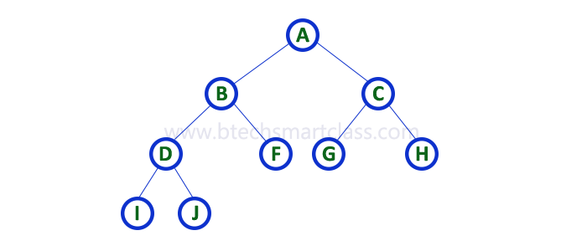
Strictly Binary Tree
A binary tree in which every node has either two or zero number of children is called Strictly Binary Tree
Strictly binary tree is also called as Full Binary Tree or Proper Binary Tree or 2-Tree

Slide 20
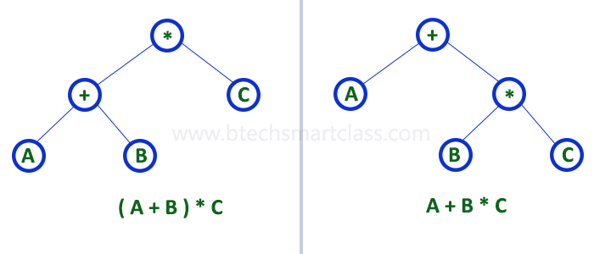
Strictly Binary Tree
Strictly binary tree data structure is used to represent mathematical expressions.

Slide 21
Complete Binary Tree
A binary tree in which every internal node has exactly two children and all leaf nodes are at same level is called Complete Binary Tree.
Complete binary tree is also called as Perfect Binary Tree
At every level of complete binary tree there must be 2^{level} number of nodes. For example at level 2 there must be 2² = 4 nodes and at level 3 there must be 2³ = 8 nodes.

Slide 22
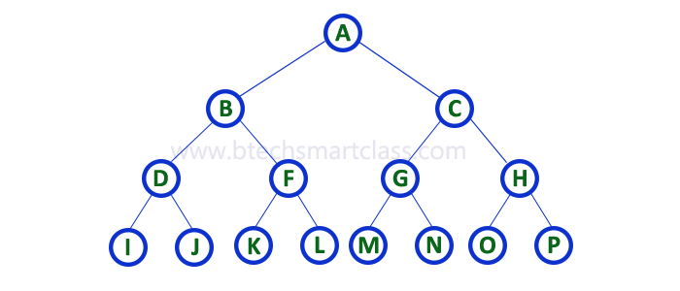
Complete Binary Tree

Slide 23
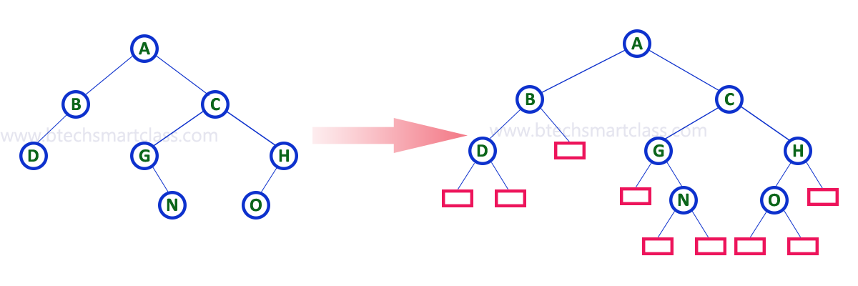
Extended Binary Tree
The full binary tree/strictly binary tree obtained by adding dummy nodes to a binary tree is called as Extended Binary Tree.

Slide 24
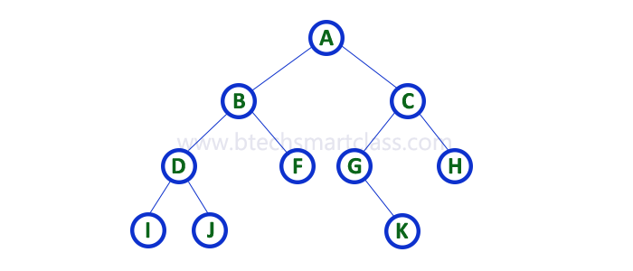

Binary Tree Representations
Array Representation

Slide 25

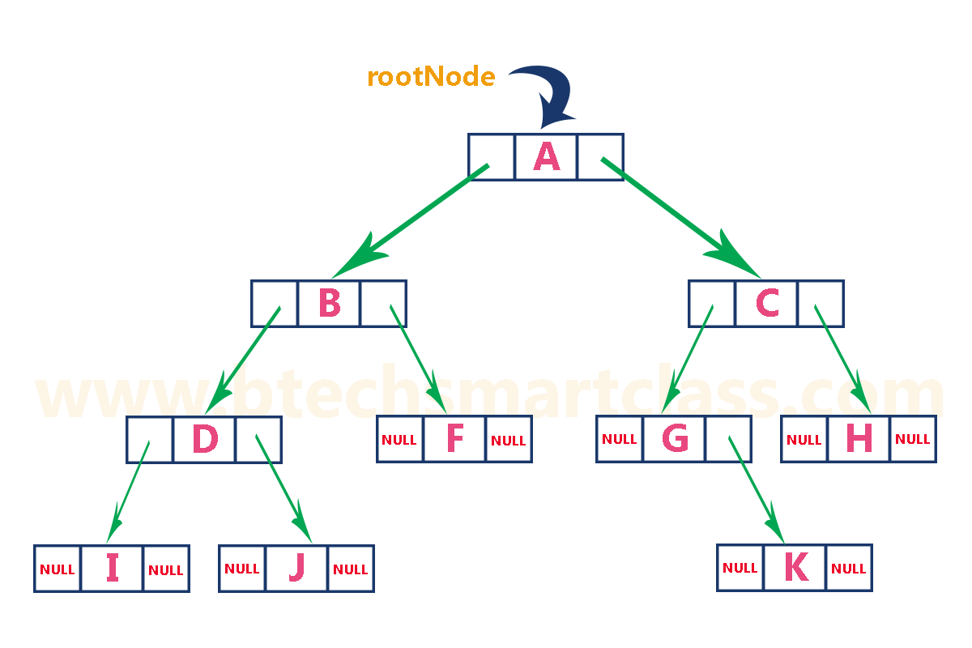
Binary Tree Representations
Linked List Representation In this linked list representation, a node
has the following structure...

Slide 26
Tree Traversal (BST)
Traversal is a process to visit all the nodes of a tree and may print their values too. Because, all nodes are connected via edges (links) we always start from the root (head) node. That is, we cannot randomly access a node in a tree. There are three ways which we use to traverse a tree −
In-order Traversal
Pre-order Traversal
Post-order Traversal
Generally, we traverse a tree to search or locate a given item or key in the tree or to print all the values it contains.

Slide 27
Tree Traversal (BST)
In-order Traversal
In this traversal method, the left subtree is visited first,
Then the root and later the right sub-tree.
We should always remember that every node may represent a subtree itself.
If a binary tree is traversed in-order, the output will produce sorted key values in an ascending order.

Slide 28
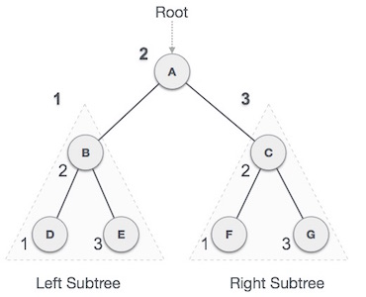
Tree Traversal (BST)
In-order Traversal
We start from A, and following in-order traversal,
we move to its left subtree B.
B is also traversed in-order.
The process goes on until all the nodes are visited.
The output of inorder traversal of this tree will be −
D → B → E → A → F → C → G
Algorithm
Until all nodes are traversed −
Step 1 − Recursively traverse left subtree.
Step 2 − Visit root node.
Step 3 − Recursively traverse right subtree.

Slide 29
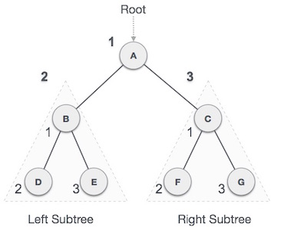
Tree Traversal (BST)
Pre-order Traversal
In this traversal method, the root node is visited first, then the left subtree and finally the right subtree.
Algorithm
Until all nodes are traversed −
Step 1 − Visit root node.
Step 2 − Recursively traverse left subtree.
Step 3 − Recursively traverse right subtree.
Output:
A → B → D → E → C → F → G

Slide 30
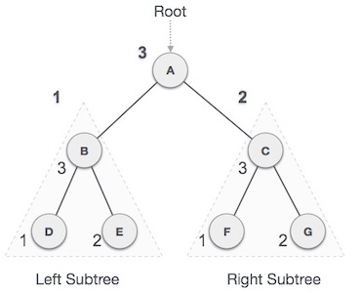
Tree Traversal (BST)
Post-order Traversal
First we traverse the left subtree, then the right subtree and finally the root node.
Algorithm
Until all nodes are traversed −
Step 1 − Recursively traverse left subtree.
Step 2 − Recursively traverse right subtree
Step 3 − Visit root node.
Output:
D → E → B → F → G → C → A

